Slide 1
Running an Exchange trip
Nicola Boggi (Beaumont)
Claire Edison (Monk’s Walk)

Slide 2
Getting off the ground!
Where to start? Need to find a school either through an agency or through a colleague/friend

Slide 3
A reccy
Do this ASAP to get a feel for the school/area.
Might not be right choice so don’t feel you have to say yes.
Visit places students might visit – risk assess.
No time? Speak to coordinator

Slide 4
Dates
Really important you get this right
Things to consider;
Gap between outbound and inbound
Both school calendars
Clashes with other trips
Term time or not?

Slide 5
Communication?

Slide 6
Numbers
Be realistic – number of students
1) Get your number first.
2) The host school picks the students they want from theirs to match our number. It’s a lot easier!

Slide 7
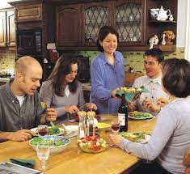
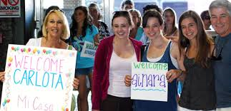
Matching
Up to you but I would do the matching!

Slide 8
Launching an Exchange
Starting a new Exchange at a school that hasn’t run an Exchange before/for a long time.

Slide 9
Put together a proposal
Once you’ve found an Exchange school, put together a proposal and arrange a time to go along to an SLT meeting to put your suggestion forward.
Things to include:
Details of the Exchange school.
Staffing and dates of the trip
An outline of the itinerary and idea of costing
Impact/outcome for the students – this is key!
What admin/support you will need to help run the trip.

Slide 10
Putting together an itinerary and costing
Research what major tourist locations are in the area.
Consider what students will find interesting, fun and engaging.
Educational element is important.
Costing as for other residential trips, but a few other things to consider:
Factor in a contribution to English staff hosting teachers on their return visit.
Include money to cover the cost of entertaining teachers when they are here.
Malvern languages produce a booklet which I buy for each student (£4.50) which includes useful phrases as well as activities for them to complete.

Slide 11
Communicating with parents and students
If an Exchange is new to your school, it’s important to be open with parents.
Do an assembly launching the Exchange, and then give out letters during language lessons.
Give as much detail as you can in the initial letter.
Explain how the matching will be done – this is key.
As with any residential trip, organise a parent information evening, but give as much detail as you can about the school etc.
Child protection – letter from head teacher.

Slide 12
While you are there
Regularly check with students that all is well in their host families.
Take a school mobile so that students can contact you if necessary.
Liaise with staff there to ensure that parents plan weekend activities for students that you are happy with.
Enjoy yourself!

Slide 13
The return visit
Organise a meeting with parents well in advance of the group’s return visit.
This should be an opportunity to reminisce (show any photos, a film, give out prizes) about your visit, as well as to give information to parents.
Ensure parents fully understand their responsibilities while the group are over.
Again, organise a school mobile so that students can contact you in case of emergency.
Organise some evening/weekend activities for the teachers so that they are made to feel welcome and want to come again!

